Slide 1
MODULE 1
Course outcome:
To gain fundamental understanding of Probability, conditional probability and Bayes theorem.

Slide 2
Module Contents:
Probability Theory: Sample space, Events, Different approaches to probability
Addition and multiplication theorems on probability
Independent events, Conditional probability, Bayes Theorem

Slide 3
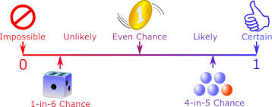
Probability
Probability is the branch of mathematics concerning numerical descriptions of how likely an event is to occur, or how likely it is that a proposition is true.
The probability of an event is a number between 0 and 1,
  0 indicates impossibility of the event
  1 indicates certainty (sure)

Slide 4

Random Experiment, Sample space & Events
A random experiment is an experiment or a process (which can be repeated under same conditions any number of times) for which the outcome cannot be predicted with certainty.
  Tossing a coin
  Picking a card
Event is one (or more) outcomes of a random experiment.
  "The 5 of Hearts" (1 element)
  "A King" (4 elements)
  "A Face card" (12 elements)
  "A Spade" (13 elements)
A sample space (S) is a collection or a set of possible outcomes of a random experiment.

Slide 5
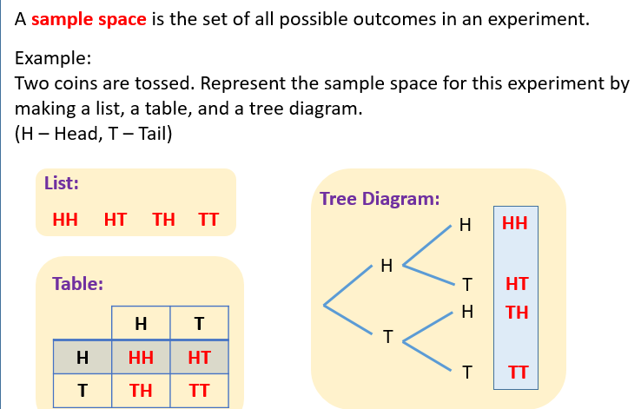
Sample space

Slide 6
Different Types of Sample Space
A sample space S can be finite, countably infinite, uncountable infinite.
A sample space S is either discrete or continuous.
A discrete sample space S is either finite or countably infinite.
Finite S, e.g.,
  S = {1, 2, 3, 4, cos(π/6), sin(π/3)}
  S = {T T, T H, HT, HH}
Countably infinite S, e.g.,
  S = {0, 1, 2, 3, ...}
  S = {T, HT, HHT, HHHT, ...}.
A continuous sample space S is Uncountable infinite
  e.g., S = {θ : 0 < θ < 2π}

Slide 7
Types of Events
Null Event:
Simple event : Any event consisting of a single point of the sample space.
  Ex: S={1,2,3,4,5,6} E={5}
Compound Events: If any event consists of more than one single point of the sample space
  Ex: S={1,2,3,4,5,6} E={2,3,5}
( ): A null event is an empty set, and has no outcomes.

Slide 8
Types of Events
Independent Events and Dependent Events:
  If the occurrence of any event is completely unaffected by the occurrence of any other event, such events are known as an independent event
    Ex: Tossing a coin 3 times to get a head in all three tosses
  The events which are affected by other events are known as dependent events.
    Ex: Drawing a King from a pack of cards 3 times
Replacement: When we put each card back after drawing it the chances don't change, as the events are independent.
Without Replacement: The chances will change, and the events are dependent.

Slide 9
Types of Events
Complementary Events
  For any event E₁ there exists another event E₁’ or E₁^{c} which represents the remaining elements of the sample space S.
    Ex: S={1,2,3,4,5,6} E₁={1,2,3} E₁^{c} ={4,5,6}
Equally likely Events: The events which are random and have an equal likelihood of occurrence.
  Ex: During a coin toss you are equally likely to get heads or tails.
Favourable cases: The cases that ensure the occurrence of an event.
Ex: When a dice is thrown the favourable cases of getting an even number are{2,4,6}

Slide 10
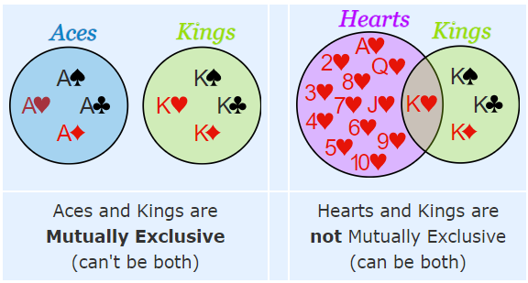
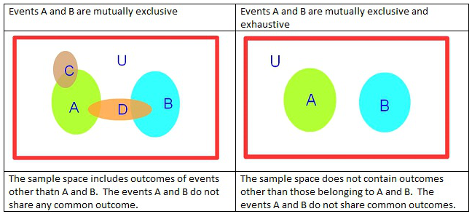
Mutually Exclusive & Exhaustive Events
Mutually Exclusive means we can't get both events at the same time.
Exhaustive events: When a sample space is distributed down into some mutually exclusive events such that their union forms the sample space itself, then such events are called exhaustive events.
When two or more events form the sample space collectively than it is known as collectively exhaustive events.
  E1={H} E2={T}
Example:
  Ex: S={1,2,3,4,5,6,7,8,9,10}
  E1={1,3,5,7,9}
  E2={2,4,6,8}

Slide 11
SAMPLE SPACE EXERCISE
We toss a coin until we see two consecutive tails. We record the total number of coin tosses.
A bag contains 44 balls: one is red, one is blue, one is white, and one is green. We choose two distinct balls and record their color in order.
A customer arrives at a bank and waits in the line. We observe TT, which is the total time (in hours) that the customer waits in the line. The bank has a strict policy that no customer waits more than 20 minutes under any circumstances.
Construct a sample space for the experiment that consists of rolling a single die. Find the events that correspond to the phrases “an even number is rolled” and “a number greater than two is rolled.”
Construct a sample space that describes all three-child families according to the genders of the children with respect to birth order.

Slide 12
Classical Approach
Relative Frequency Theory of Probability
Subjective Probability
Axiomatic Approach of Probability
MEASURES OF PROBABILITY

Slide 13

Classical Approach (Prior Probability)
Classical Approach (Prior Probability): When all the outcomes are equally likely,
What is the chance of getting a king in a draw from a pack of 52 cards?
  P(getting a king ) =4/52 = 1/13
Two coins are tossed simultaneously. What is the probability of getting a head and a tail?
S={HH, HT, TH, TT}
Fav outcomes ={HT, TH}
P(head and tail) = 2/4 = 1/2

Slide 14
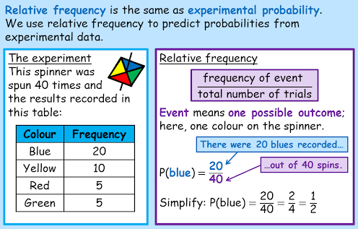
Relative Frequency Theory of Probability

Slide 15
Subjective Probability
Subjective probability is a type of probability derived from an individual's personal judgment or own experience about whether a specific outcome is likely to occur.
It contains no formal calculations and only reflects the subject's opinions and past experience.
Ex: Prediction of a sport event
A doctor predicting 50% chance of need of a heart transplant based on his past experience

Slide 16
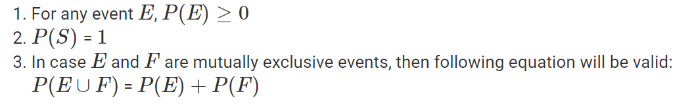
Axiomatic Approach of Probability
Let, S be the sample space of any random experiment and let P be the probability of occurrence of any event.

Slide 17
Two dice are thrown. Find the probability that :
  (a) the total of the numbers on the dice is 8,
  (b) the first die shows 6,
  (c) the total of the numbers on the dice is greater than 8,
  (d) the total of the numbers on the dice is 13,
  (e) both the dice show the same number,
  (f) the sum of the numbers shown by the dice is less than 5,
  (g) the sum of the numbers shown by the dice is exactly 6.

Slide 18
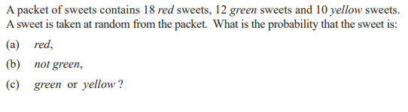

Slide 19
Addition Theorem
Not Mutually Exclusive Events:
if A and B are any two events then the probability of happening of at least one of the events is defined as P(AUB) = P(A) + P(B)- P(A∩B).
The probability that a student passes a Physics test is (2/3) and the probability that he passes both Physics and English test is (14/45). The probability that he passes at least one test is (4/5). What is the probability that the student passes the English test?

Slide 20
Addition Theorem
Mutually Exclusive Events:
If A and B are any two mutually exclusive events then P(A∩B)=0
  P(AUB) = P(A)+P(B).
A bag contains 4 white, 3 black and 5 red balls. What is the probability of getting a white or a red ball at random in a single draw ?

Slide 21
Conditional Probability
If A and B are two independent events the conditional probability of A given B is defined as
  P(A/B) = P(AՈB)/P(B)
Similarly, conditional probability of B given A is defined as
  P(B/A) = P(AՈB)/P(A)

Slide 22
Multiplication Theorem
Multiplication Theorem states that if A and B are two dependent events, then the probability of their simultaneous occurrence is equal to the probability of one event multiplied by the conditional probability of the other.
  P(A/B) = P(AՈB)/P(B)=> P(AՈB) = P(B)*P(A/B)
  P(B/A) = P(AՈB)/P(A) =>P(AՈB) = P(A)*P(B/A)

Slide 23
Multiplication Theorem
If two events A and B are independent, then the probability that both will occur is equal to the product of the respective probabilities.
P(AՈB) = P(A)*P(B)
The probability that X and Y will be alive ten years hence is 0.5 and 0.8 respectively. What is the probability that both of them
i)will be alive ten years hence ?
ii)will not be alive ten years hence ?
Also find the probability that either of them will be alive after 10 years.

Slide 24
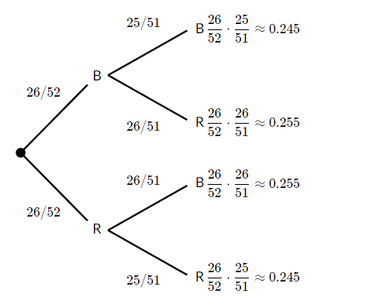
Multiplication Theorem
Consider drawing two cards, without replacement, from a standard deck of 52 cards. That means we are drawing the first card, leaving it out, and then drawing the second card. What is the probability that both cards selected are black?
P(both black card) = P(firstblackcard)*P(secondblackcard/first card is black)
=26/52 * 25/51 = ½ * 25/51 = 25/102 =0.245

Slide 25
Multiplication Theorem
A university has to select an examiner from a list of 50 persons, 20 of them women and 30 men, 10 of them knowing Hindi and 40 not. 15 of them being teachers and the remaining 35 not. What is the probability of the University selecting a Hindi-knowing women teacher ?
Probability of selecting a women =20/ 50 =2/5
Probability of selecting a teacher =15/50 =3/10
Probability of selecting a Hindi-knowing candidate =10/50 =1/5
Probability (selecting a hindi knowing women teacher) = 2/5*3/10*1/5 =3/125

Slide 26
A problem in statistics is given to three students A, B, C whose chances of solving it are 1/2, 1/3, 1/4 respectively. What is the probability that the problem will be solved ?

Slide 27
The probability that A speaks truth is 4/5, while its probability for B is 3⁄4, the probability that they contradict each other when asked to speak on a fact is:

Slide 28
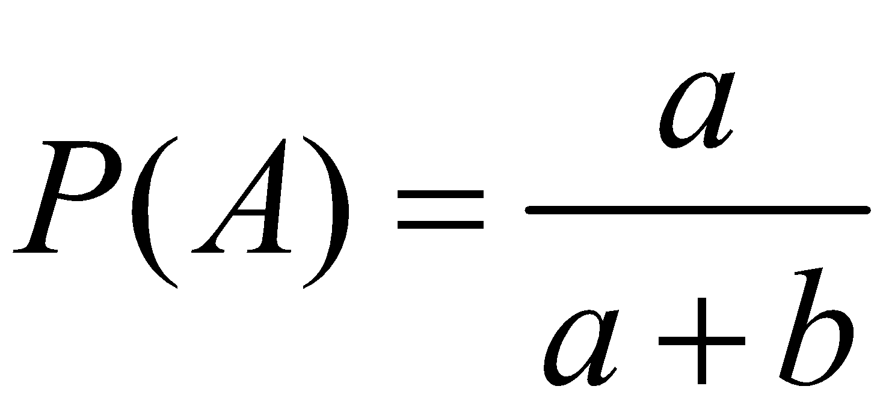
Odds
Odds relate the chances in favour of an event to the chances against it.
If the odds that an event A occurs is a:b, then
Example: If the odds of James winning or losing the Game are 9:2, what is the subjective probability that he will win?
P(James winning) = 9/11

Slide 29
If two dice are thrown, what is the probability that the sum is
(a) greater than 9, and
(b) neither 7 nor II?

Slide 30
A card is drawn from a well-shuffled pack of playing cards. What is the probability that it is either a spade or an ace?

Slide 31
The Odds against manager X settling the wage dispute with the workers are 8:6 and odds in favor of manager Y settling the same dispute are 14:16.
(a) what is the chance that neither settles the dispute, if they both try, independently of each other?
(b) what is the probability that the dispute will be settled?

Slide 32
Bayes' Theorem
Inverse Probability
Bayes’ Theorem is a fundamental result in probability theory that describes the probability of an event based on prior knowledge of conditions that might be related to the event.

Slide 33
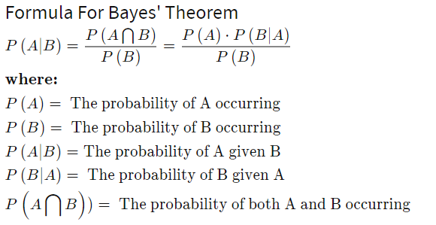
Bayes Theorem
Bayes' theorem allows you to update predicted probabilities of an event by incorporating new information.

Slide 34
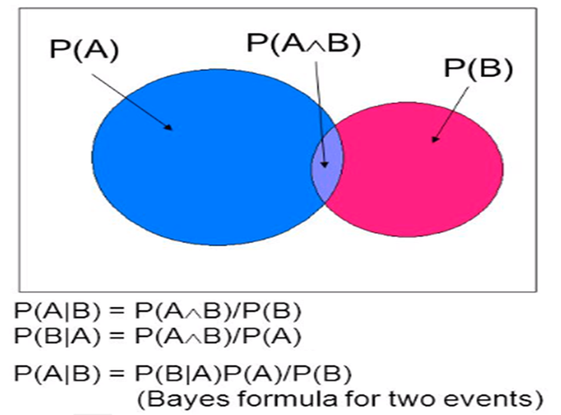
BAYE’S THEOREM

Slide 35
There are two identical urns containing respectively 6 black and 4 red balls, 2 black and 2 red balls. An urn is chosen at random and a ball is drawn from it.
(I) find the probability that the ball is black
(ii) if the ball is black, what is the probability that it is from the first urn?
P(Black) = ? P(U1/B) = ?
P(B/U1) = 6/10
P(B/U2) = 2/4 =1/2
P(Black) = P(U1).P(B/U1)+P(U2)P(B/U2)
= ½ *6/10 + ½*2/4
= 3/10 +1/4 = 11/20
P(U1/B) = P(B/U1)*P(U1) = 6/10*1/2 = 6/20 = 6/11
P(B) 11/20 11/20

Slide 36
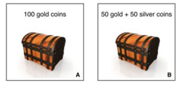
You randomly choose a treasure chest to open, and then randomly choose a coin from the treasure chest. If the coin you choose is gold, what is the probability you chose chest A?

Slide 37
A company has two plants to manufacture scooters. Plant I manufactures 80% of the scooters and plant II manufactures 20%. At plant I, 85 out of 100 scooters are rated as of standard quality and at plant II, 65 out of 100 scooters are rated as of standard quality. A scooter is chosen at random and is found to be of standard quality. What is the probability that it has come from plant II?

Slide 38
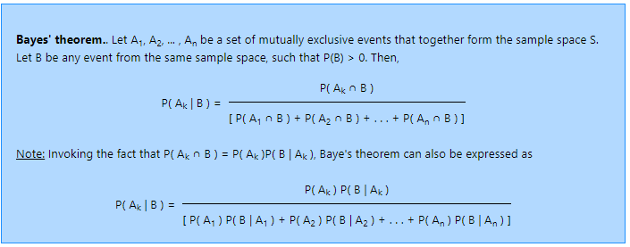
BAYE’S THEOREM

Slide 39
A speaks truth 3 times out of 4 while B does so 7 times out of 10. A ball is drawn at random from a bag containing one black ball and five other balls of different colors. Both A and B report that a black ball has been drawn from the bag. What is the probability of their assertion being true?

Slide 40
In an objective type examination, each question has four options of which only one is correct. A student taking the examination either guesses or copies or knows the answer to any question. The probability that he guesses is 1/3 and that the he copies is 1/6 . the probability that he answers correctly if he copies is 1/8. If an answer is given to be correct, find the probability that the student knew the answer.

Slide 41
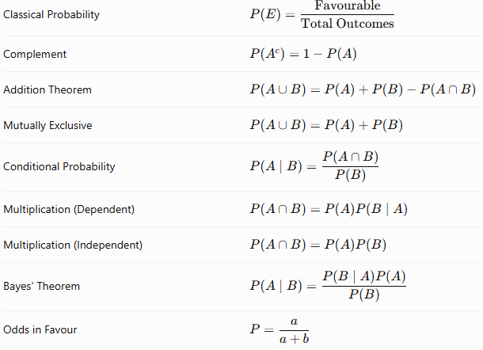
Summary

